Slide 1
TITLE
01 / 10
Healthy Economies, Healthy Communities
Turning low-IGS communities into local opportunity through CAN - a small-business-anchored platform.
Community analyzed: EOTR DC tracts with Inclusive Growth Score below 45
Challenge focus
Our thesis
In communities with IGS below 45, how do economic conditions affect healthcare access, and how can small businesses help improve outcomes?
Economic conditions block healthcare access in low-IGS tracts. Small businesses are the most leveraged response, but only if residents can start them and stakeholders can find them. CAN connects both sides.
Selected community
Submission goal
EOTR low-IGS tract pool.
46 tracts analyzed.
Median IGS 38 vs 56 in the rest of DC.
Show the data -> opportunity -> small business -> stakeholder support -> impact loop.
Mastercard Data Science Challenge Finals | Healthy economies, healthy communities.
Notes:
Lead with CAN in one sentence: Mastercard-anchored data becomes local opportunity when residents can start businesses and stakeholders can fund what the data surfaces.

Slide 2
OBJECTIVE / PROBLEM STATEMENT
02 / 10
Objective and problem statement: if care is nearby, why is access still failing?
Problem statement
Our objective is to explain how economic conditions block healthcare use even when facilities are geographically close.
The real barrier is economic friction, not geographic distance. The intervention has to be economic, and small businesses are how communities create the services they lack.
14 of 18 proximity tests point the wrong way for distance-first policy
Food insecurity in EOTR
Medical-care proximity in the same tracts
48.3
0.57
0.31
21.9
Highest 10 FI tracts
Lowest 10 FI tracts
Highest 10 FI tracts
Lowest 10 FI tracts
Project analysis from 01_findings.ipynb and data_pipeline.py using USDA Food Access, DC Built Environment, and CDC PLACES tract data.
Notes:
Open on the paradox, then pivot: if care is near and outcomes are still worse, the binding constraint is economic friction. That is the reason CAN exists.

Slide 3
COMMUNITY OVERVIEW
03 / 10
Community overview: low-score tracts cluster east of the river
Our selected community is a corridor of EOTR neighborhoods where low Inclusive Growth Scores and high distress are concentrated inside one part of DC.
Community pool: 46 EOTR tracts selected for analysis
2025 Inclusive Growth Score distribution across DC tracts
46
EOTR tracts
94
EOTR tracts in the community pool
Rest of DC
Low-score corridor inside DC.
16,281
42
Residents in top five launch tracts
Named launch sites in this corridor.
28
21
11
6
46.2%
0
2
0
1
0-24
25-34
35-44
45-54
55+
Average food insecurity in top five tracts
Tract count by score band
High-need launch set.
Community overview from Mastercard IGS 2025 tract scores and current launch-tract targeting.
Notes:
Use this slide to define the community before benchmarking it. The histogram shows that low-score tracts are not randomly spread across DC; they cluster east of the river.

Slide 4
IGS BENCHMARKING
04 / 10
IGS benchmarking: EOTR clears the challenge threshold by a wide margin
Every analyzed EOTR tract sits below 45, with a median IGS of 38 versus 56 in the rest of DC.
Challenge threshold: Inclusive Growth Score <45
EOTR tract pool and phase-1 launch tracts
46
38
96.02
N
Analyzed EOTR tracts
Median EOTR IGS
78.08
All meet the challenge threshold.
Versus 56 in the rest of DC
75.03
74.08
56
33
74.03
Rest of DC median IGS
Economy pillar median
Same-city benchmark.
Weakest pillar.
Gray = all EOTR tracts | color = named phase-1 launch tracts
Benchmark interpretation
Challenge eligibility is established at the tract-pool level first; launch tracts are then selected as Phase-1 deployment markets for CAN.
IGS benchmarking from Mastercard tract scores, validated against the current deployment analysis.
Notes:
Benchmark first, then narrow. This slide makes the sub-45 rule and the rest-of-DC comparison impossible to miss, then names the phase-1 CAN markets.

Slide 5
KEY FINDINGS
05 / 10
Key findings: access friction is economic and time-based, not just geographic
DC-wide modeling shows that labor-market weakness, financing gaps, and travel friction are more stable signals than clinic distance.
The stable predictors are inclusive-growth conditions: labor engagement, small-business financing, travel time, internet access, and housing.
0.69 R²
0.61 R²
1000x
205
5-fold CV on 205 DC tracts
Held-out test performance
Bootstrap Lasso resamples
DC tracts in primary model
Out-of-sample support for the claim.
Keeps the pitch honest about predictive power.
Stable features instead of one noisy pick.
EOTR used as confirmation, not the only sample.
Most stable predictors of food insecurity
Plain-English takeaway
100
99.7
96.7
92
90.3
Access friction is economic and time-based, not just geographic.
What this means for the intervention
Labor Market Engagement
Small Business Loans
Travel Time to Work
Internet Access
Affordable Housing
The predictors are economic. The response has to address small-business formation and local opportunity, not just service delivery.
Project analysis from 02_evidence_chain.ipynb using DC-wide tract modeling, 5-fold LassoCV, RidgeCV, and bootstrap stability.
Notes:
Say the model result in plain English before the R-squared, then connect it directly to CAN: small-business formation is a better match for the data than another access site.

Slide 6
HEALTHCARE ACCESS CONTEXT
06 / 10
Healthcare access context: why nearby care still goes unused
Residents may be geographically close to care but still unable to use it because care competes with work schedules, travel time, unstable income, digital gaps, and weak local service infrastructure.
Place
Economy
Community
Finding: care is geographically nearby, but commute and visit time still block use.
Pilot response: show residents which gaps exist in their neighborhood through a Community Pulse dashboard.
Finding: labor-market weakness and low small-business financing are stable predictors of food insecurity.
Pilot response: let residents start businesses to fill those gaps with AI-powered planning support.
Finding: trust, digital access, and repeat use shape whether services are actually used.
Pilot response: connect residents to stakeholders who fund, hire, and mentor from the same platform.
Challenge answer in one sentence
In low-IGS EOTR communities, economic conditions affect healthcare access by making routine care too costly in time, coordination, and reliability to use consistently.
Place / Economy / Community alignment synthesized from the official challenge framing and current analysis.
Notes:
This is still the cleanest answer to the prompt. Then add one line: CAN attacks those upstream economic conditions rather than only changing the last-mile access experience.

Slide 7
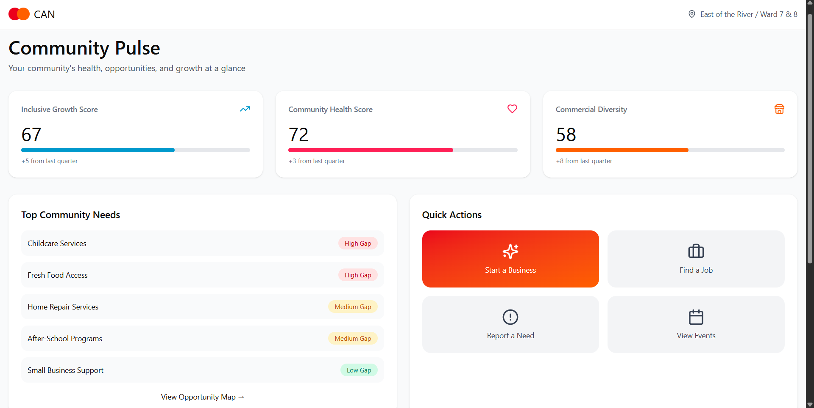
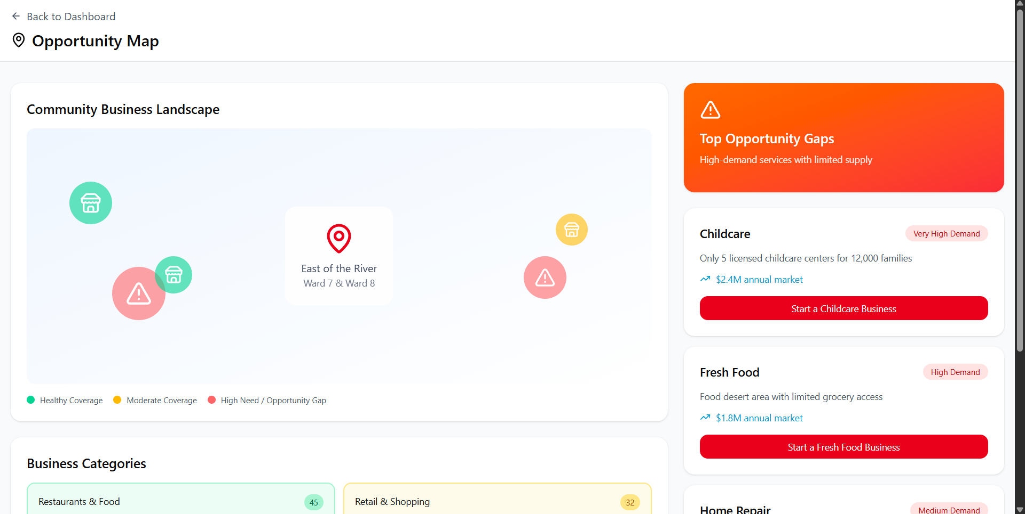
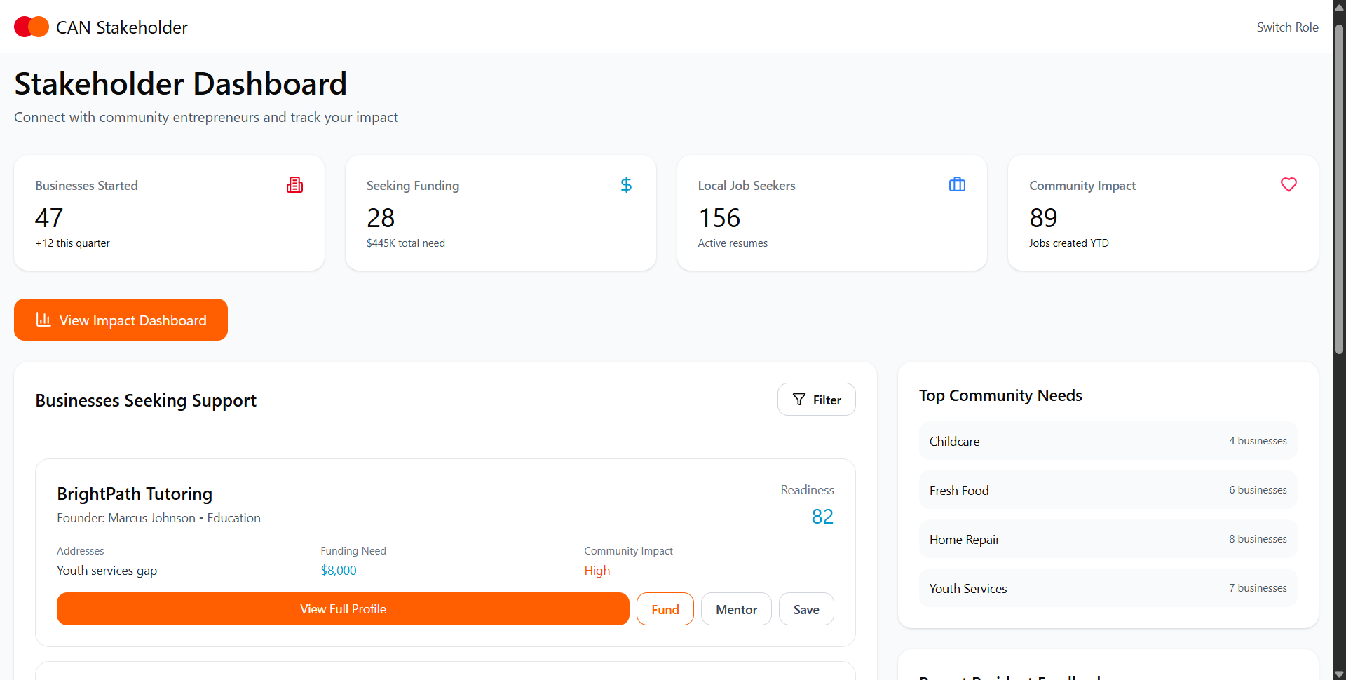
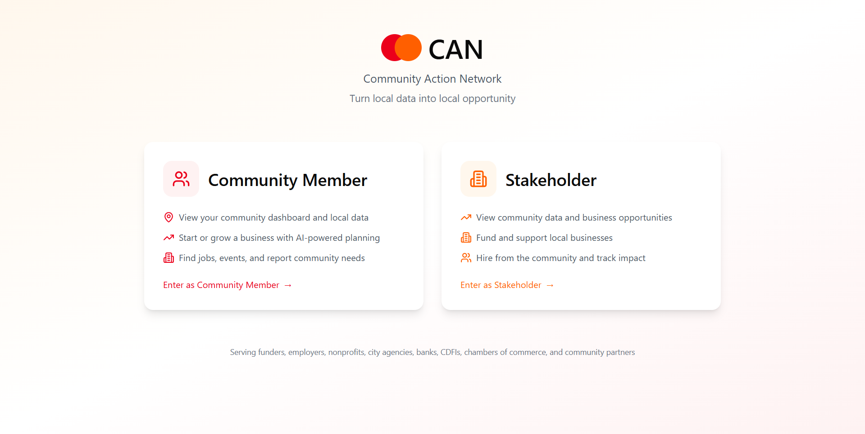
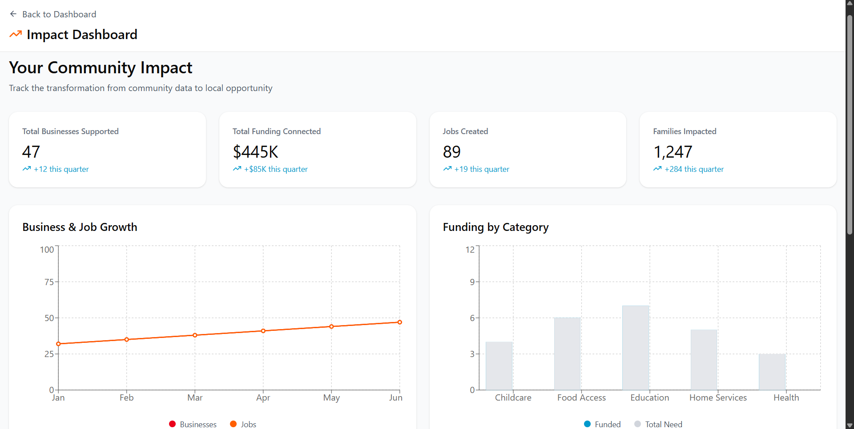
PROPOSED SMALL-BUSINESS SOLUTIONS
07 / 10
CAN: Community Action Network
Two sides of the same map: residents start, stakeholders support, and IGS measures.
Community Pulse
Opportunity Map
Stakeholder Dashboard
Residents see their IGS, health, and commercial-diversity scores. Top community needs are surfaced as opportunity gaps.
Gaps become business opportunities. Childcare, fresh food, and home repair become visible as local demand.
Funders, employers, and CDFIs see businesses tagged by community need and filtered by readiness or support type.
Two-sided platform entry
Impact dashboard
Residents enter to build; stakeholders enter to fund, hire, and measure impact from the same CAN system.
CAN tracks funding connected ($445K), jobs created (89), and businesses supported (47) against IGS-aligned outcomes.
Community data -> opportunity gap -> resident starts business -> stakeholder funds -> IGS-tracked impact.
CAN prototype screenshots from the April 27, 2026 Figma Make build. On-screen platform metrics are mock pilot targets adopted as CAN year-1 goals for the pitch.
Notes:
This slide is the CAN reveal. Narrate the loop from left to right: residents see the gap, convert it into a business plan, stakeholders fund or hire, and Mastercard measures neighborhood impact.

Slide 8
IMPLEMENTATION CONSIDERATIONS
08 / 10
How CAN deploys, operates, and stops
The platform pilot is concrete: five named tracts, community onboarding, stakeholder participation, and explicit stop/pivot rules.
Phase 1 footprint
Mastercard layer
Five named EOTR launch tracts.
About 16,281 residents in the initial focus set.
Community onboarding through Howard, faith institutions, FQHC outreach, and local partners.
IGS feeds Community Pulse.
Payment rails route stakeholder funding to resident-owned businesses.
Merchant and partner network accelerates community and stakeholder onboarding.
Cost
Stop/pivot rules
$500K covers platform development, AI infrastructure, community onboarding, stakeholder partnerships, and 18 months of operations across the five launch tracts.
Resident sign-ups stay below 200 in Phase 1.
Stakeholders engage with fewer than 25% of visible business profiles.
AI planning output is rated unhelpful by a majority of users.
CAN prototype screenshots from the April 27, 2026 Figma Make build. On-screen platform metrics are mock pilot targets adopted as CAN year-1 goals for the pitch. Need x Readiness ranking from 02_evidence_chain.ipynb using food insecurity, transportation barriers, distress, business diversity, loans, and disconnection.
Notes:
This is where Mastercard becomes the operating layer: IGS targeting, funding rails, and measurable community deployment. Keep the stop rules crisp and non-defensive.

Slide 9
METRICS FOR SUCCESS
09 / 10
Metrics for success aligned to IGS pillars
The pilot should be judged through access, economic, and community signals that map back to Place, Economy, and Community.
Access / Place
Economic / Economy
Community
Target: residents reached by Community Pulse.
Checkpoint: opportunity gaps surfaced and acted on in each pilot tract.
Signals: dashboard usage, opportunity clicks, and return visits.
Target: businesses launched, $445K in stakeholder funding connected, and 89 jobs created.
Signals: commercial diversity score improvement and businesses moving from planning to launch.
Target: directional movement in IGS-aligned indicators.
Signals: top community needs trending downward, follow-through on support, and stronger local hiring loops.
What counts as success by month 12
The same framework that identified the gaps should show whether CAN closed them. That means resident usage, business formation, stakeholder engagement, and community indicators all need to move together.
CAN prototype screenshots from the April 27, 2026 Figma Make build. On-screen platform metrics are mock pilot targets adopted as CAN year-1 goals for the pitch.
Notes:
Use the prototype numbers as explicit year-1 targets: funding connected and jobs created come from the CAN dashboards, then roll them back to IGS-aligned measurement.

Slide 10
CONCLUSION / ACKNOWLEDGEMENTS
10 / 10
Conclusion, ask, and acknowledgements
Fund a measurable platform for turning low-IGS community gaps into resident-owned economic opportunity.
$500K
18 months
5 tracts
CAN
Pilot budget
Deployment window
Phase-1 community focus
Platform deliverable
18 months to launch and evaluate.
Six months to launch, twelve to measure.
Selected from the EOTR low-IGS pool.
Community data -> opportunity -> support.
Revised core thesis
What Mastercard enables
Healthcare access in EOTR is downstream of economic conditions. CAN turns IGS data into local opportunity by helping residents start the businesses their communities need and helping stakeholders find them. Small businesses are the mechanism.
The $500K covers platform development, AI infrastructure, community deployment in five launch tracts, stakeholder onboarding, and 18 months of measured operations.
Same city. One river apart. In DC, life expectancy still varies by roughly 20 years across neighborhoods. That is an inclusive-growth failure.
The data, the partners, and the payment infrastructure exist. The question is whether we can turn them into a measurable access model. CAN is that model.
Data sources: Mastercard IGS, CDC PLACES, ACS, USDA Food Access Atlas, DC Built Environment, HRSA, SBA designations, DC Health 2024 Health Systems Plan.
Howard University | Team Data Benders
Somkenechukwu Onwusika | Oritsejemiyotan Atsagbede | Moyinoluwa Ogunjobi
Healthy economies, healthy communities | Official 10-slide submission deck.
Notes:
Close on the platform loop: economic conditions shape access, CAN turns that evidence into business creation, and Mastercard makes the funding and measurement layer real.

